Slide 1
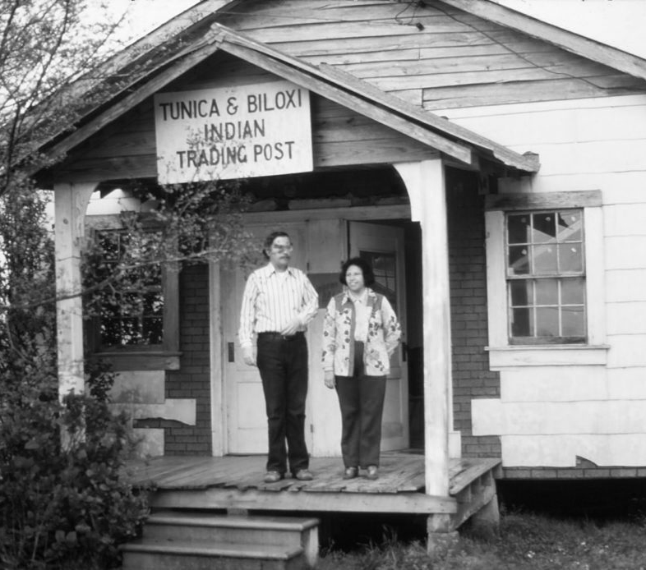
ABOUT US
Tunica-Biloxi Services, LLC (TBS) was formed as a wholly owned subsidiary of the Tunica-Biloxi Tribe of Louisiana to provide high-impact administrative and general management services to federal organizations. TBS is a solution focused organization that specializes in facilities management, design-build construction, professional services, logistics and operational support
services. We are proud to support the economic development efforts of the Tribe and to contribute to the mission of: “Cherishing our Past, Building for our Future.”
As a portfolio company of TBI Federal, we bring the acquisition advantages of a Tribal 8(a) organization with the execution rigor of seasoned federal leaders. This arrangement offers access to streamlined contracting pathways while providing high-quality, accountable service delivery.
TBS offers extensive expertise and lessons learned to provide capable solutions to contract requirements in an expeditious manner born from years of performing on federal, state, local, and commercial requirements. We accomplish this with an experience and empowered management team, in-depth understanding of the mission, and leveraging the strengths of our employees and partners.
Expert Support. Safety First. Reliability You Can Trust.
CAPABILITIES
CONSTRUCTION SERVICES AND FACILITY MAINTENANCE
Design Build Services
Mechanical, Electrical, & Plumbing
Renovation
Roofing
Disaster Recovery
Heavt Civil Construction
Repair & Maintenance
Security Systems
Snow and Ice Removal
PROFESSIONAL SERVICES
Program, project, and portfolio management support
Information Technology
Security, Surveillance, Recon
Staffing Services
Human Resources Services
Consulting Services
LOGISTICS SERVICES
CONUS AND OCONUS Material Storage Distribution
Inventory Management
Procurement Services
TUNICA-BILOXI SERVICES
CORPORATE OVERVIEW
tbifederal.com

Slide 2





JOINT VENTURES
Tunica-Biloxi Services has several active joint ventures that offer cost efficient and innovative solutions, allowing TBS to expand our partnerships to include the knowledge and expertise of other industry leaders while ensuring higher quality services and broader opportunities to support our federal clients.
TUNICA-BILOXI LEMOINE JV
Provides expert Infrastructure to Building Construction, Disaster Response and Recovery, and comprehensive Project and Program Services
TUNICA-BILOXI JSTAR JV
Delivers high-quality general construction services to federal, state, and local agencies.
TUNICA-BILOXI GOVSTRIVE JV
Industry leader delivering unmatched, best-in-class HR Support, Call Center, and Professional Service to federal
organizations.
CONTRACT WITH US
CAGE: 9AUM7
Unique Entity ID: GJK7YN4ZVM15
SBA Tribal 8(a) Certified
HUBZone Qualified
Small Disadvantaged Business
Active Facility Clearance
POINTS OF CONTACT
James B. Sasser
Strategic Advisor
james.sasser@tbifederal.com
678.916.8039
HEADQUARTERS
Tunica-Biloxi Reservation Marksville, Louisiana
FIELD OFFICES
Dublin, GA
Arlington, VA Atlanta, GA
Clyde Thompson
President
clyde.thompson@tbifederal.com
478.304.3080
info@tbifederal.com
TUNICA-BILOXI SERVICES
CORPORATE OVERVIEW
tbifederal.com

